Slide 1
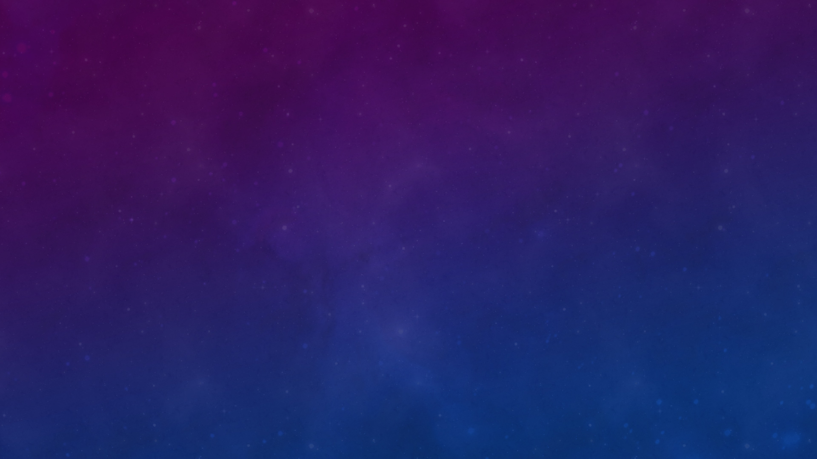

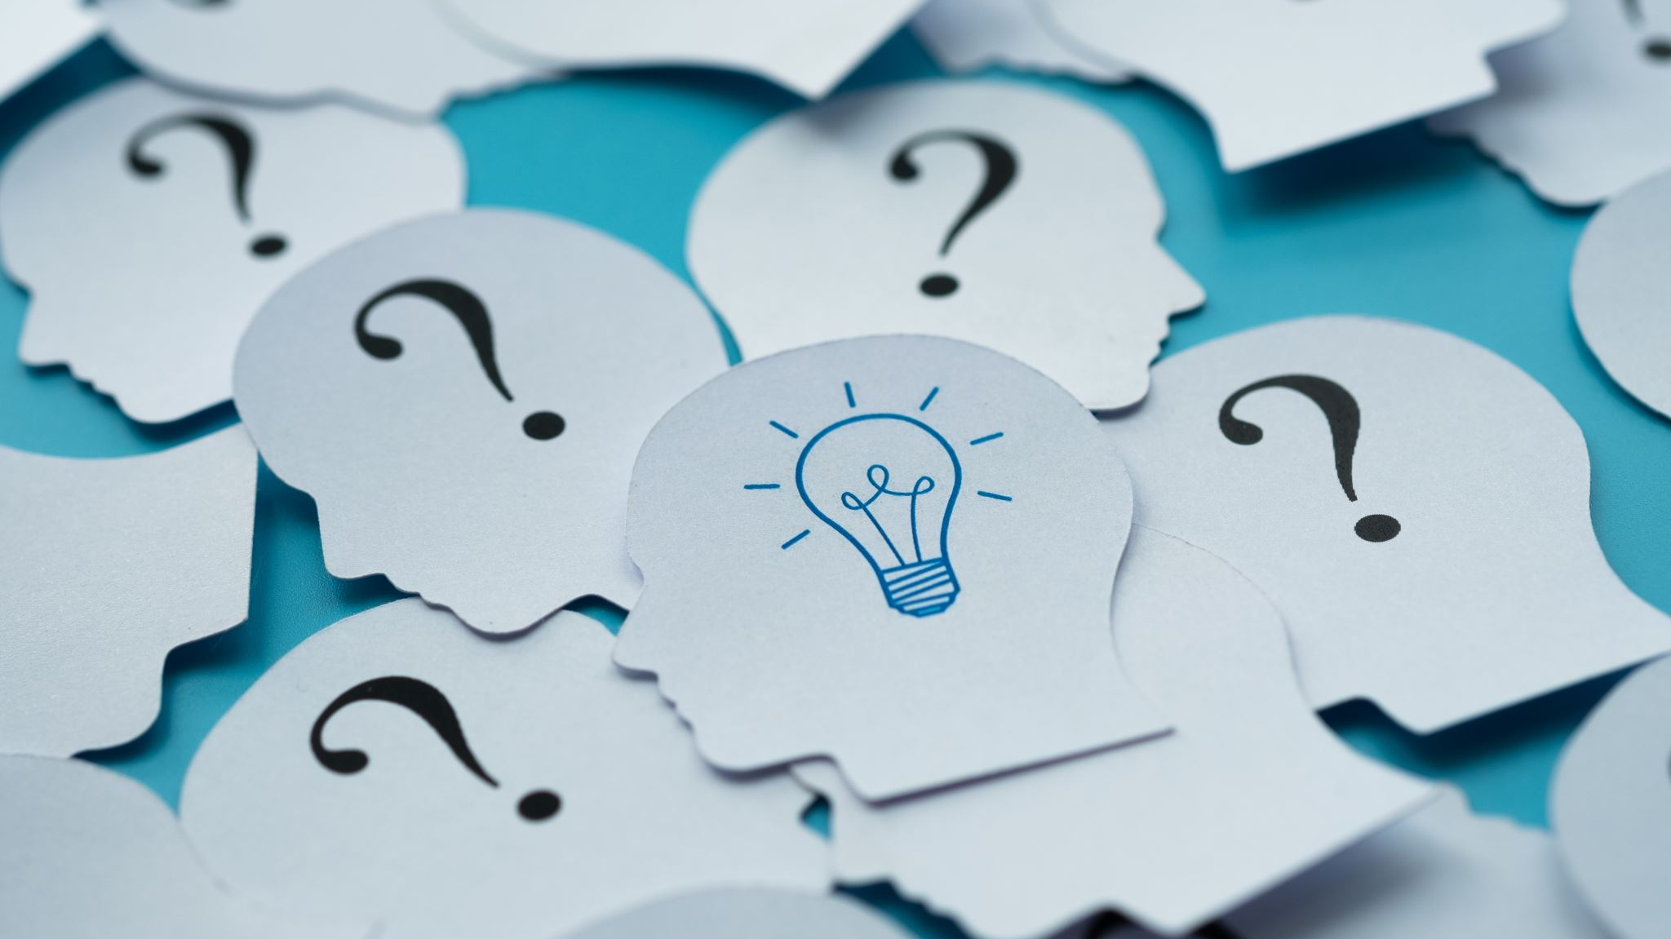
mIND mentor
Done by:
Abdelrahman Sobeih / Osama Machael/ Basel Tarify/ Youssouf Moutaoukil

Slide 2


What is the Problem?
Individuals with Attention-deficit/hyperactivity disorder (ADHD), and learning disorders lack software support for learning and focus.
The are very well known causes of difficulties for learning.
The proposal suggests creating software that incorporates traditional alertness techniques from psychiatrists to address these issues.

Slide 3
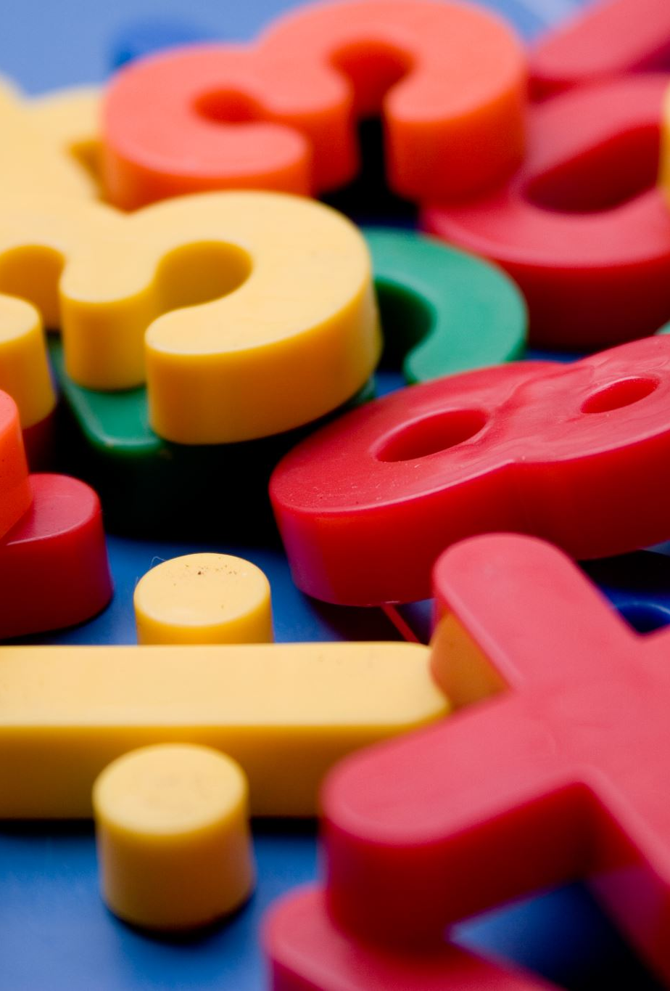
What is ADHD and Learning Disorders?
ADHD causes difficulty in focusing, controlling impulses, and remaining still, impacting school, work, and relationships.
Children with ADHD may seem distracted due to attention challenges.
Children with dyslexia (a common learning disorder) may appear distracted as reading requires substantial effort, leading to fatigue.
Understanding their conditions prevents self-blame and negative self-perceptions like "I am stupid" or "I am dumb" in children.

Slide 4
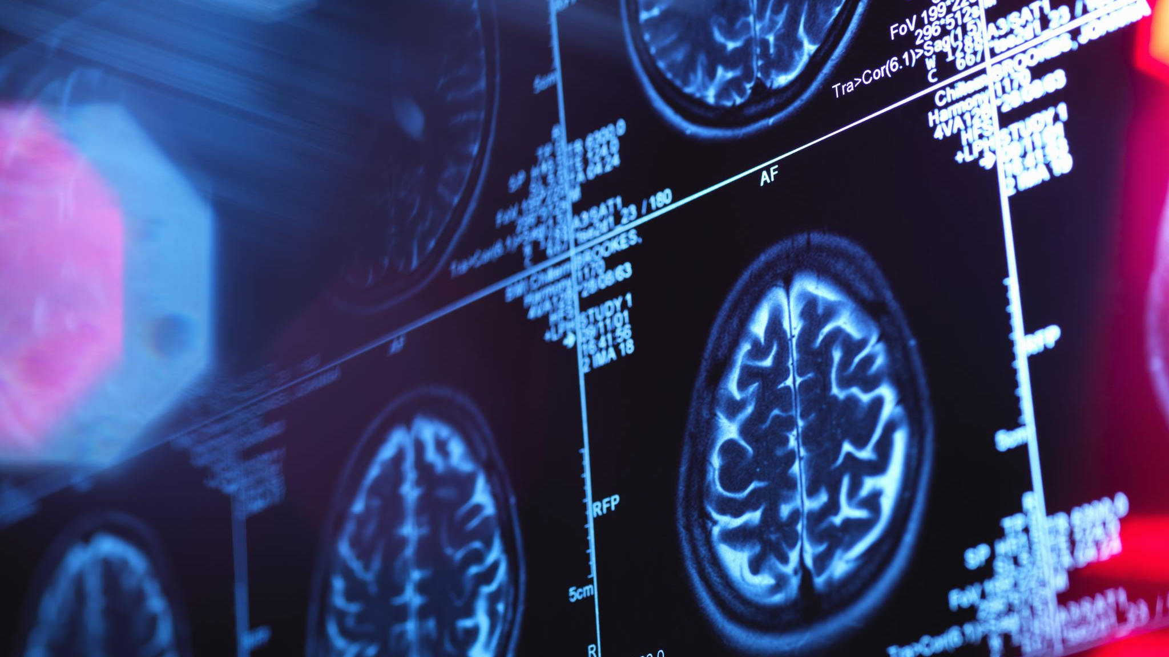
Why though?
The Centers for Disease Control and Prevention (CDC) reports a 9.8% diagnosis rate of ADHD in children aged three to 17.
Yale University notes that dyslexia affects 20% of the population, constituting 80–90% of all learning disabilities.
Statistics indicate a significant overlap, with 25-40% of individuals with ADHD also having dyslexia.
Some exceptionally bright children face struggles with both ADHD and dyslexia, emphasizing the need for a proper support system to unlock their potential.

Slide 5
The Traditional Approach (Psychiatry’s approach)
Behavioral therapy
1
School accommodations
3
Lifestyle changes
4
Tutoring
5
Phonics
6
Parent training
2

Slide 6
Our Solution (Proposal)
The software innovatively transforms traditional methods by creating an attention-grabbing interface, facilitating better knowledge absorption.
Diverse approaches, such as employing varied colors, Text to Speech, and gradual content presentation, are utilized.
Additionally, integrating the Metaverse to enhance the overall learning experience.

Slide 7
The UN Sustainable Development Goals
Since the target is people, this software help in making an easier, creative, interesting way of learning to help people learn and understand better.
The software fits with the “Good Health and Well-Being” goal since the target is people difficulties in learing, ADHD people, and others with learning disorders.
“Quality Education” is another goal that is combined to provide excellent learning environments for better understanding of their health.

Slide 8

The Software; The Digital Approach using the Studied Techniques
Front page; geeting to know the student, how would their case be best described.
Using that description, we perform certain Machine Learning (ML) model to give the best commands for the user.
Upload page; where the student puts the content and then gets generated.

Slide 9
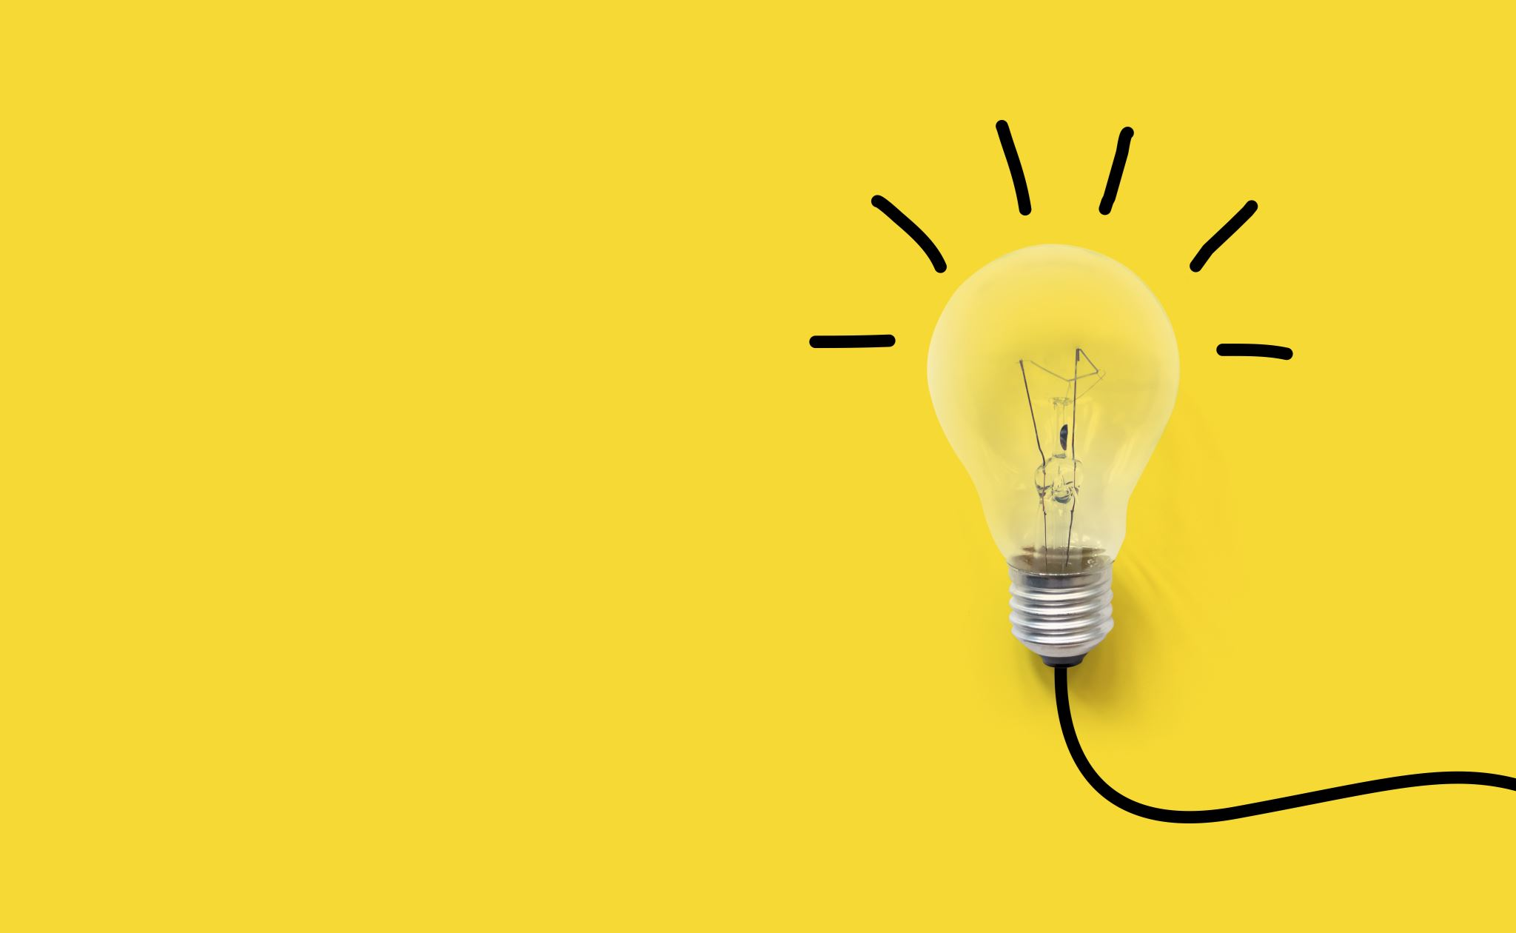
The Inclusion of Metaversity (Why?!)
The Metaverse is a digital universe offering endless opportunities for socializing, gaming, working, and exploring beyond physical constraints.
Think of it as internet coming to life!
Immersive Learning Experiences, Accessibility and Inclusivity, Collaborative Learning, and Personalized Learning are all benefits could be used to help enhancing the learning experience.

Slide 10
The Metaverse Option
After uploading, the option of getting into the metaverse give a whole new experience with the inclusion of techniques to help with the learning process.
For example, the content is in uploaded, some flashes in corners to grab attention, the student looks and therefore clicks, and the content gradually appears in a nice way.
By applying that, the user would have a higher chance for ingesting the knowledge due to their intrest of doing it.

Slide 11
Sample User Interfaces

Slide 12
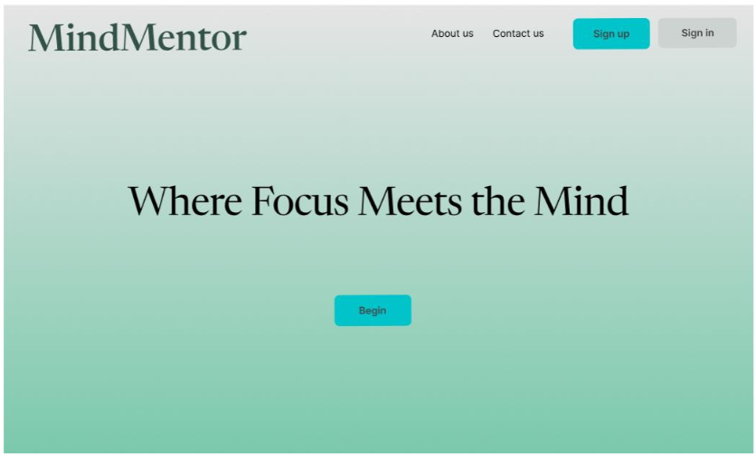

Slide 13
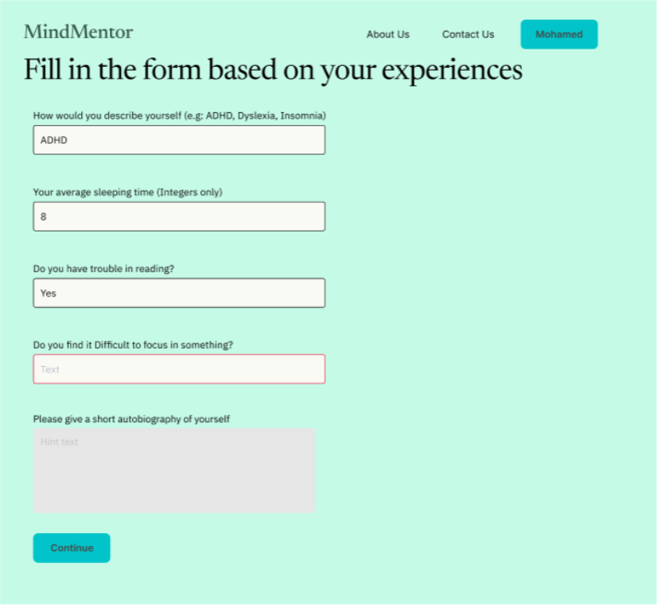

Slide 14
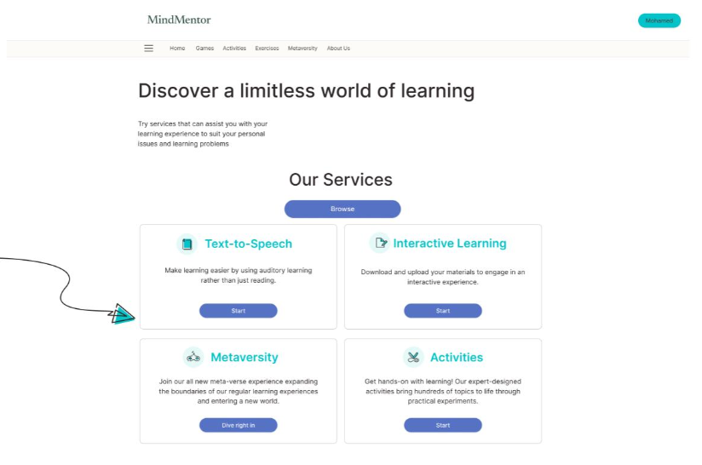

Slide 15
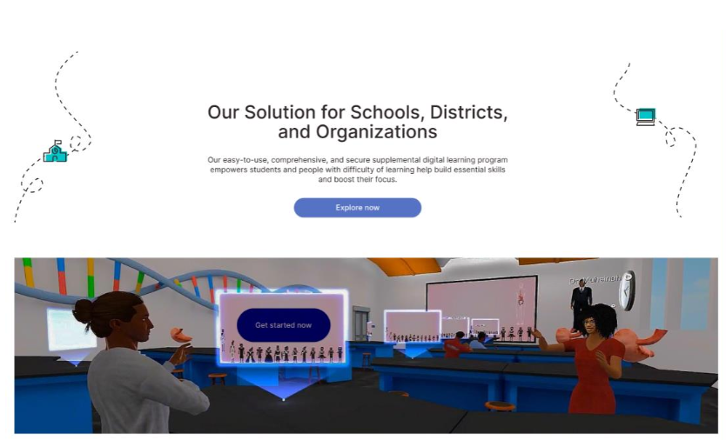

Slide 16
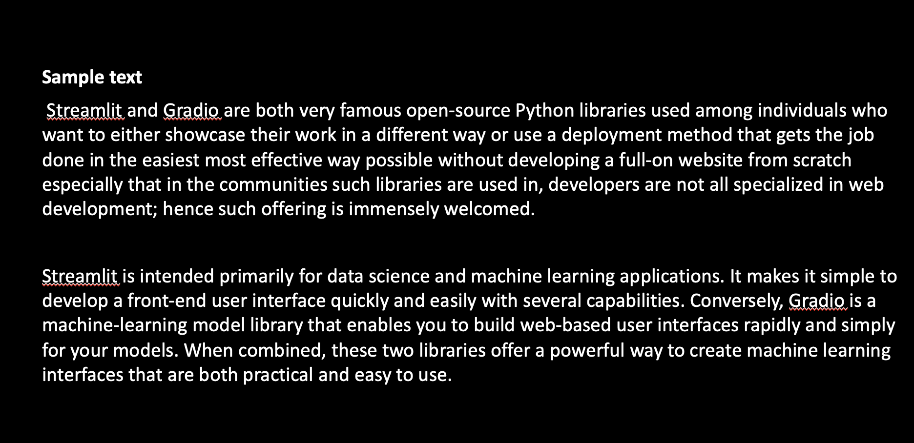
An EXAMPLE OF a SERVICE (bEFORE)

Slide 17
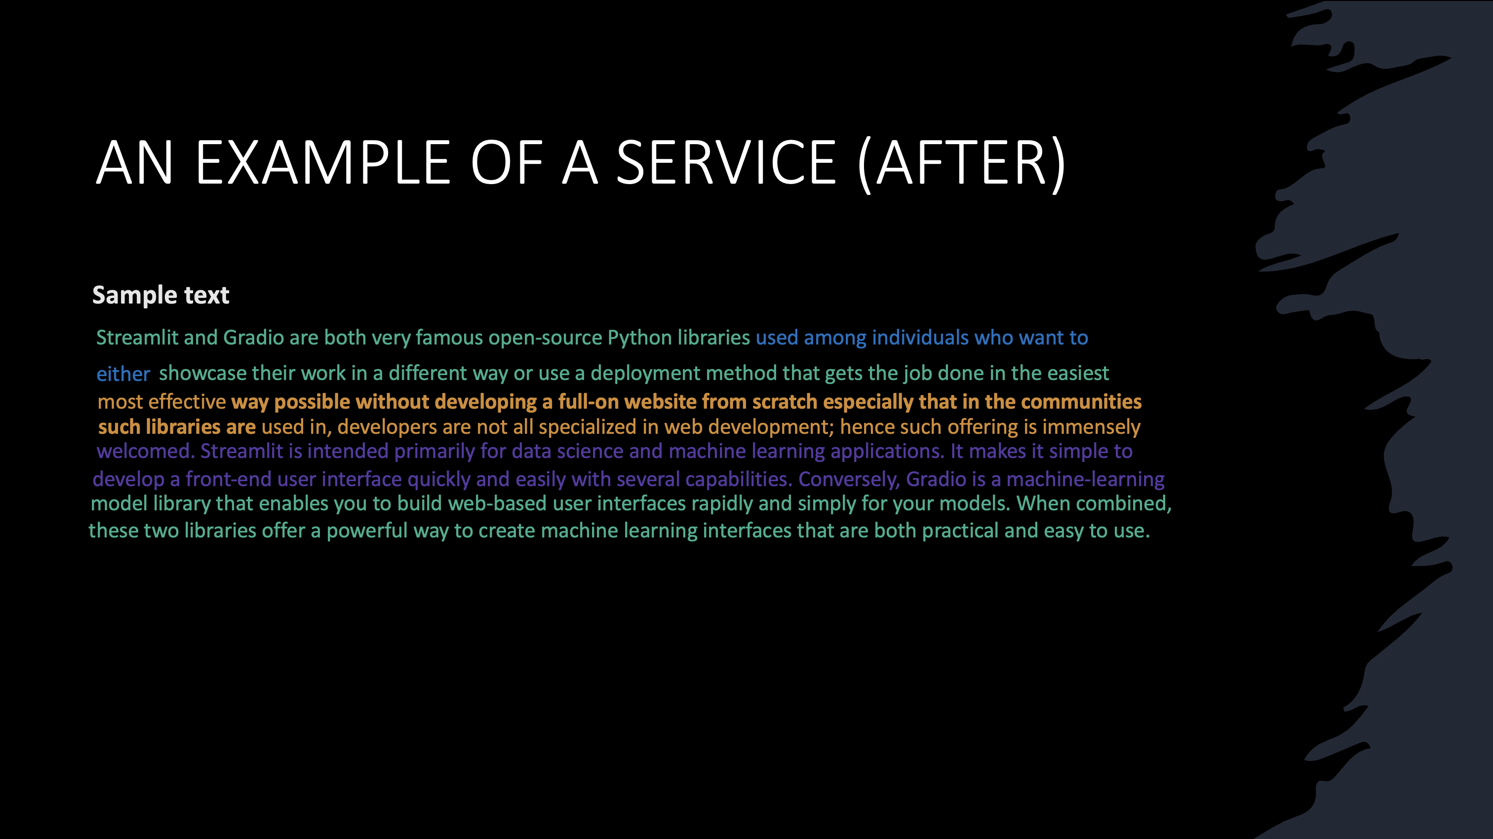

Slide 18
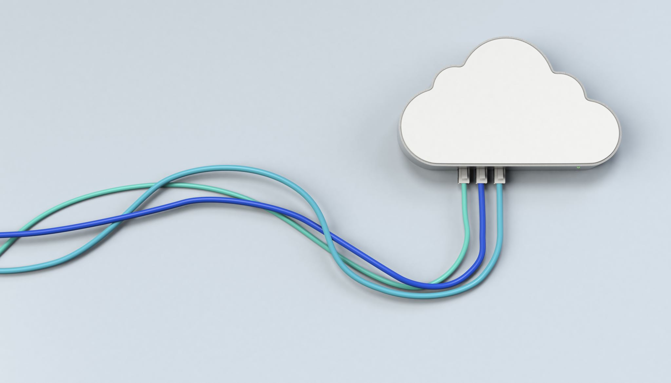
Google Technologies Used
Using Gemini as a search helper to use Google’s search engine for direct repsponses for clarifications
Google Cloud Services would be fitting for handling the backend of the Software.
Flutter is the main framwork for the software to be used for the development.

Slide 19
tHANK yOU!!

